Slide 1
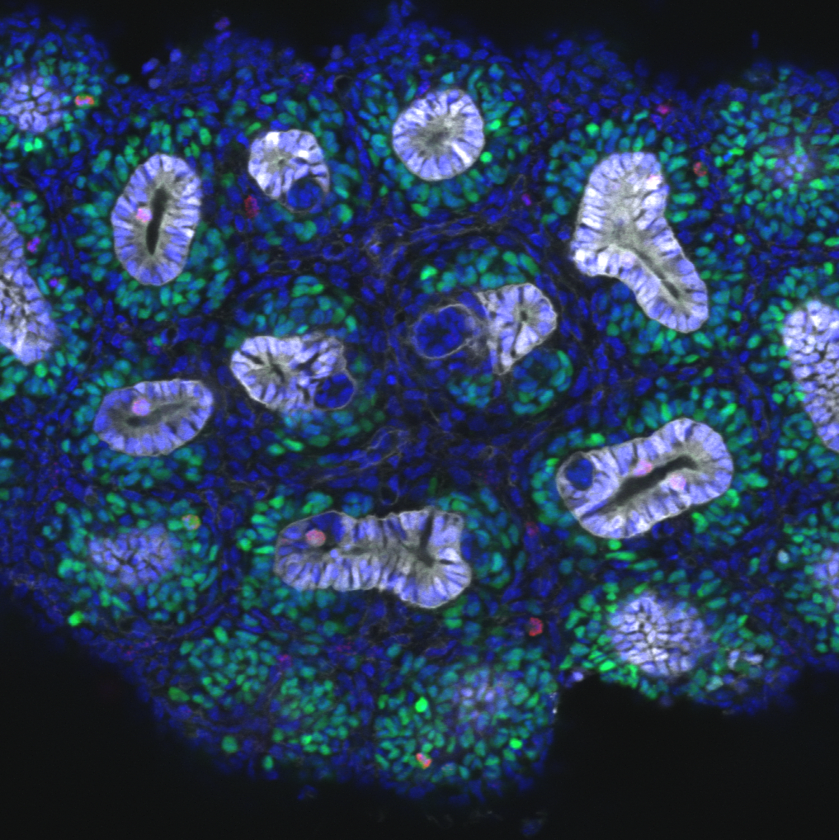
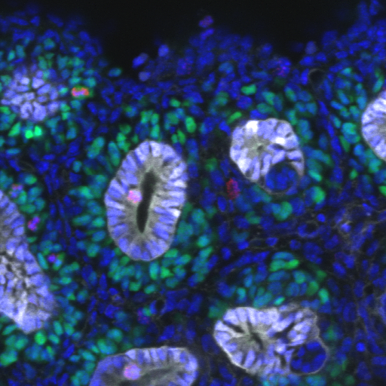
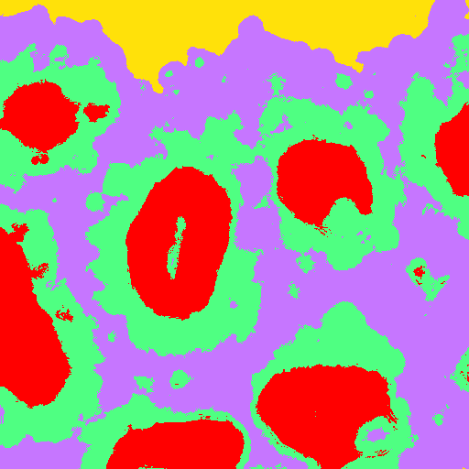
Datasets and slides:
https://github.com/doktor-nick/adv-ML-image-segmentation-with-UNET
Advanced Machine Learning Image Segmentation with UNET
Dr Nick Hamilton
Institute Bio-Mathematician
Institute for Molecular Bioscience
Research Computing Centre
Queensland Cyber Infrastructure Foundation
n.hamilton@imb.uq.edu.au
www.imb.uq.edu.au
Power corrupts.
PowerPoint corrupts absolutely.
- Edward Tufte
Images: Melissa Little Lab
© Dr Nick 2021

Slide 2
Outline
Brief machine vision applications overview
Semantic image segmentation
The UNET architecture for image segmentation
Setting up Google Colab
Exercises
Introduction for UNET
More advanced UNET use

Slide 3
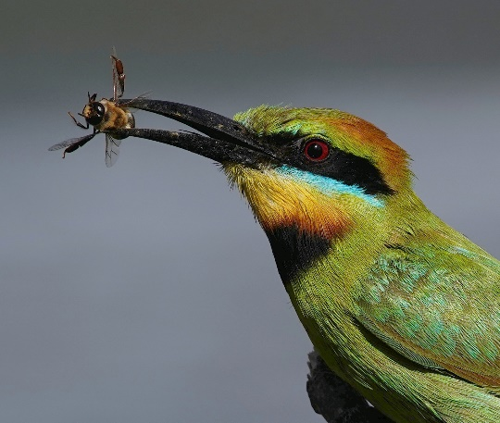
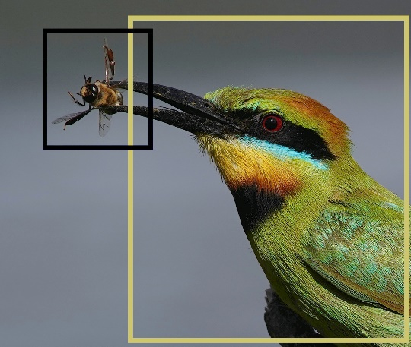
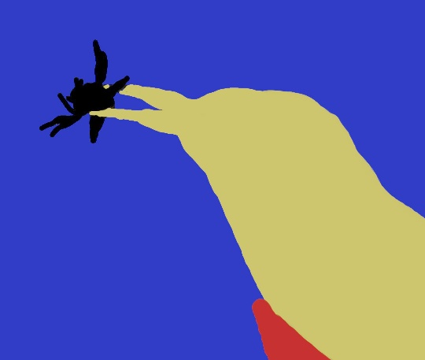
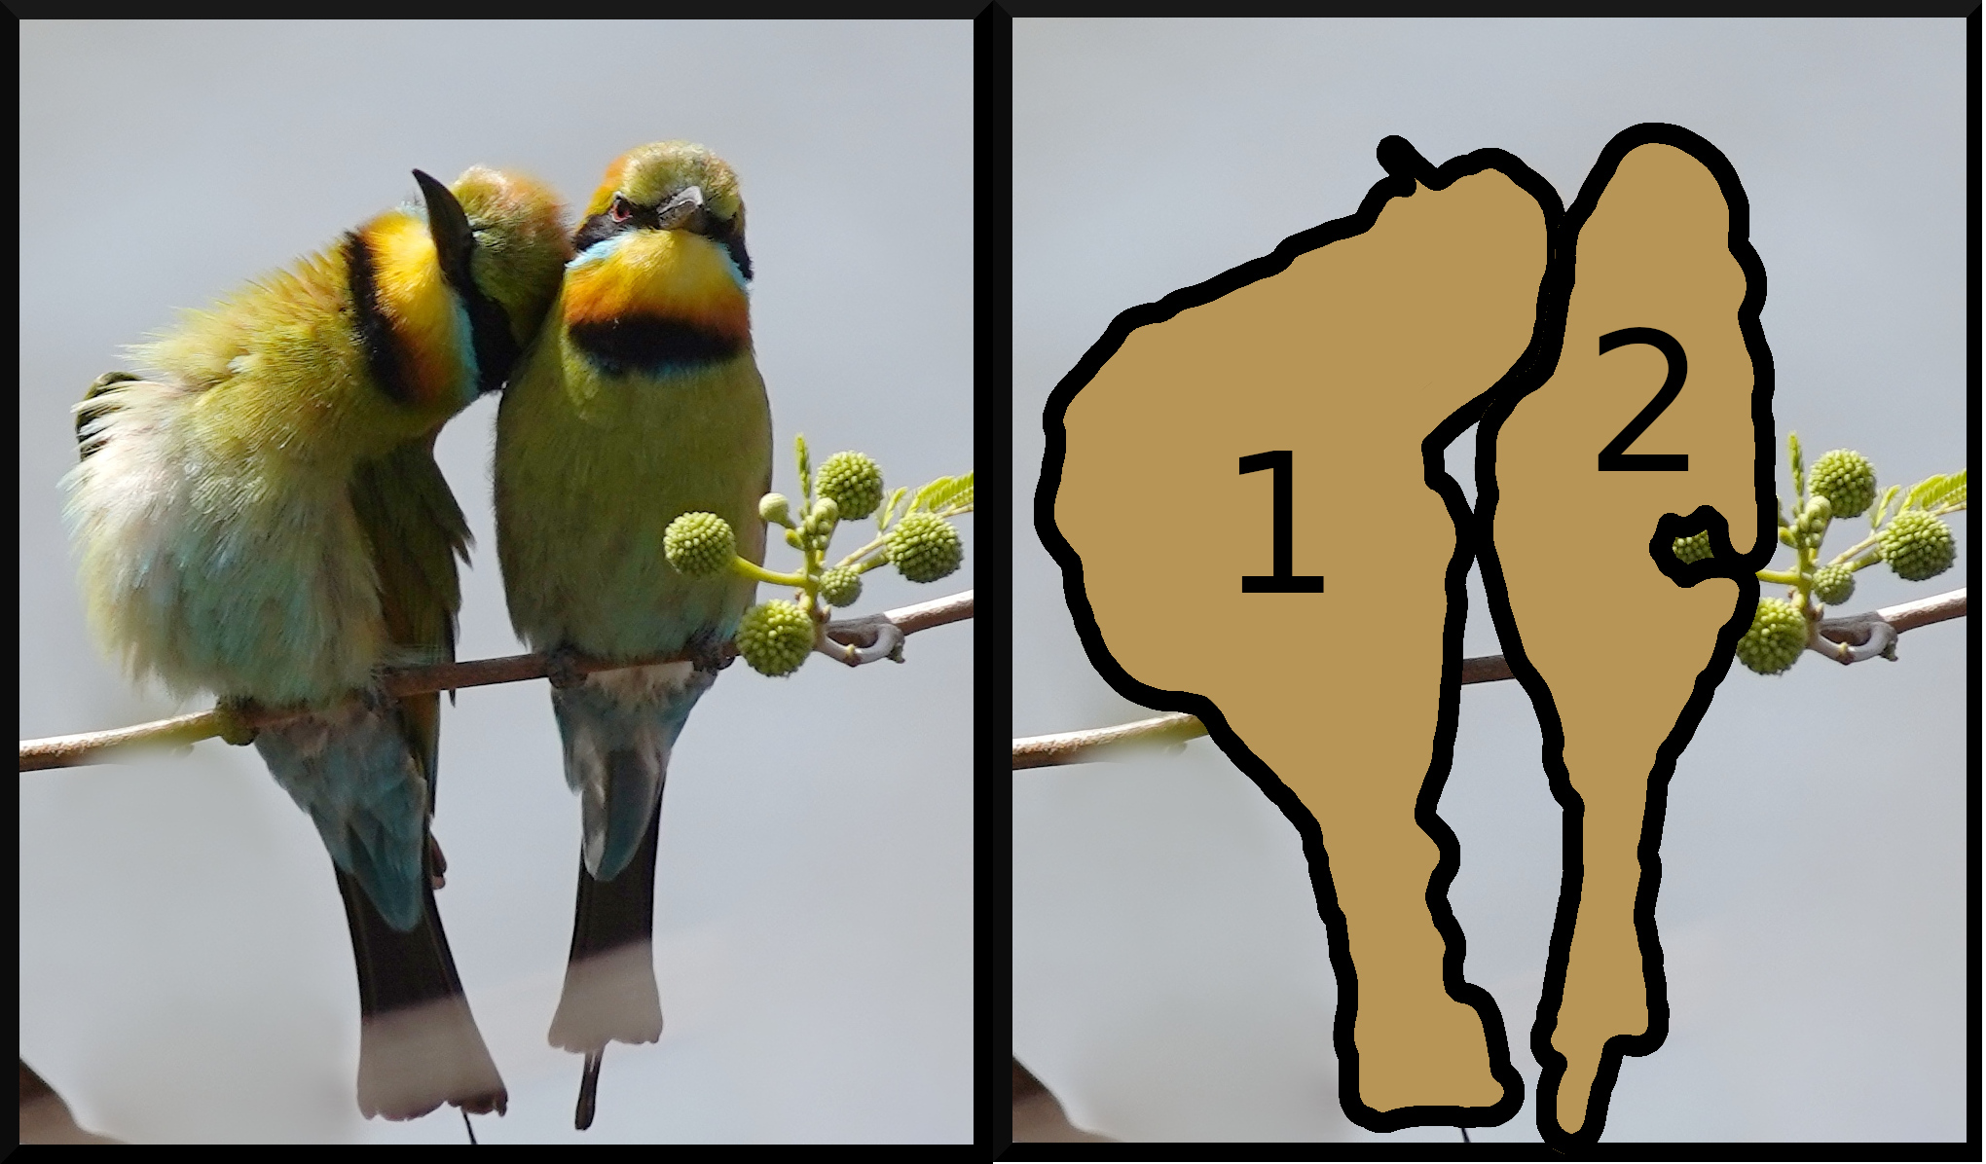
Applications of Computer Vision
Classification
Semantic Segmentation
Object Detection
Instance Segmentation
Rainbow bee-eater
Bee-eater, bee
Bee-eater, bee, stick,
background
Bee-eater 1 and 2

Slide 4
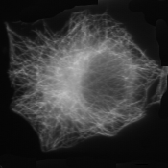
Image Classification
( 0.000772532, 0.00154506, 0.00343348, 0.0139056, 0.0308155,
0.0440343, 0.0337339, 0.0433476, 0.828412, 0.000235031,
0.000352547, 0.00205653, 0.00593454, 0.0223867, 0.0351372,
0.022093, 0.0312004, 0.880604, 0.000420663, 0.00117786,
0.00496382, 0.0165741, 0.058388, 0.107017, 0.0904425,
0.110803, 0.61024)
Cell
Cytoskeleton
=
Machine
learning
classifier
Generate
statistics
Notes:
Stats: e.g. intensity, variance, edges, …
<number>

Slide 5
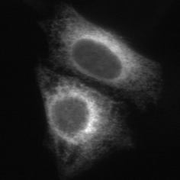
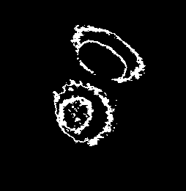
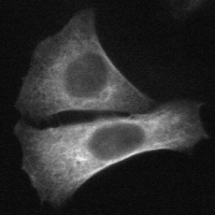
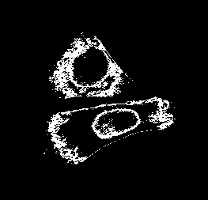
Threshold Adjacency Statistics
ER
Microtubules
Let µ be the mean intensity in the image
(Band pass) threshold intensity in range (µ, µ+30)
Hamilton, Pantelic, Hanson, Teasdale, BMC Bioinformatics 8:110
Notes:
<number>
Human eye only few tens of gray scale values. First image stats specifically designed for subcellular imaging.

Slide 6
Threshold Adjacency Statistics (TAS)
Count number “on” pixels with
0 on neighbours
1 on neighbour
…
8 on neighbours
}
Nine image statistics
Notes:
<number>
normalise

Slide 7
Image Segmentation

Slide 8
Semantic Image Segmentation
Definition
A segmentation is a partition of an image into regions that label the class of each region. e.g. foreground/background
Approach
Instead of a whole image we want to label/classify individual pixels
Ureteric tree
Cap mesenchyme
Stroma
Background
Ureteric tree
Cap mesenchyme
Stroma
Background
Microscopy image of a kidney by Alex Combes, Melissa Little Lab
Notes:
<number>

Slide 9
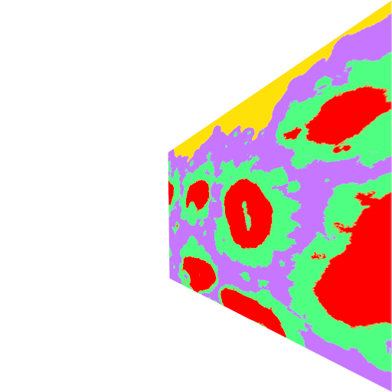
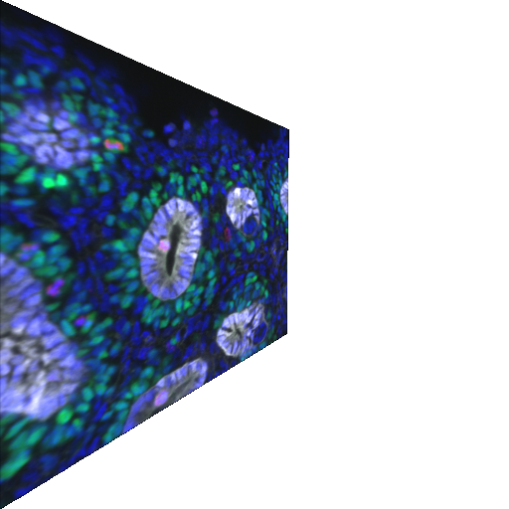
Basic Image Segmentation
Generate statistics for each pixel in the image
E.g. intensity, local median intensity, gradient, …
Classify that pixel using machine learning
(0.1,1.4,-1.5, 0.2, 2.3)
stats for
each pixel
classify

Slide 10
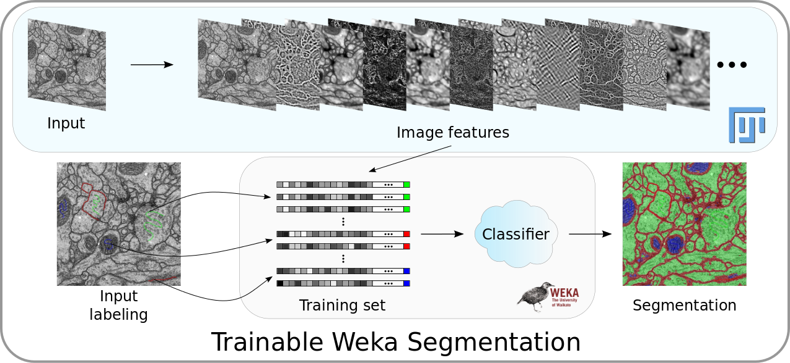
The ImageJ/Fiji Trainable Weka Pipeline
See “Introduction to Machine Learning for Imaging” workshop
Image: https://imagej.net/Trainable_Weka_Segmentation

Slide 11
The UNET Architecture for Image Segmentation

Slide 12
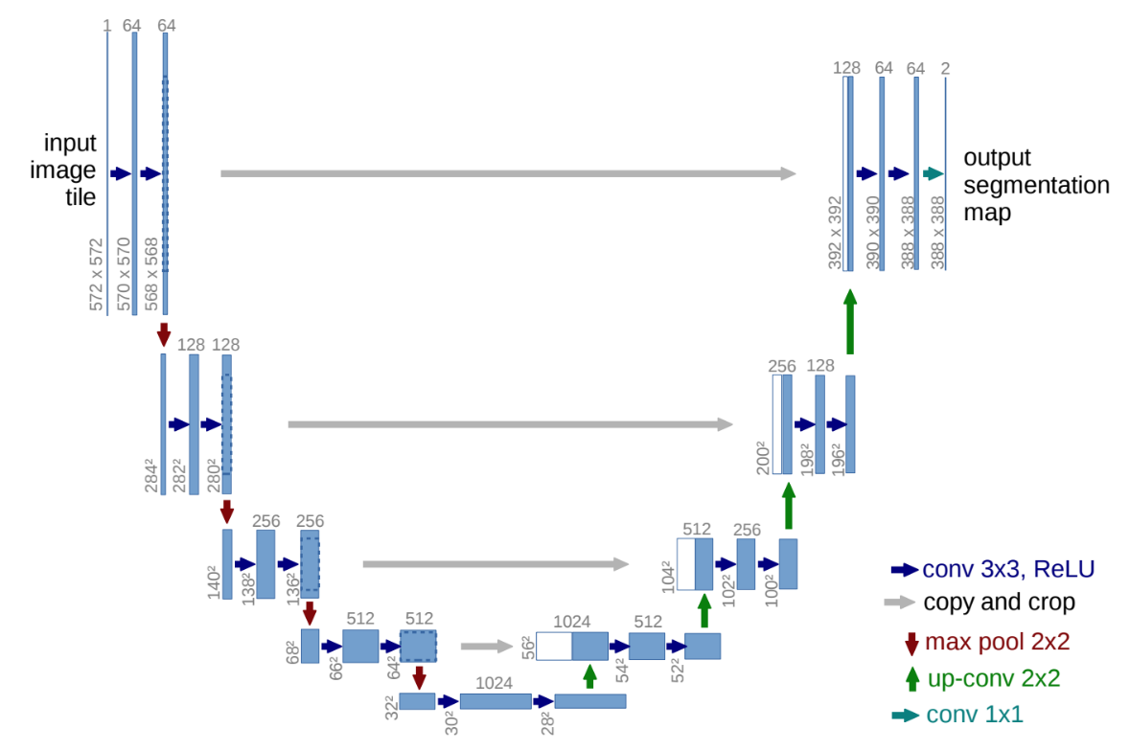
Convolutional Deep Learning with U-net
U-net was a new type of neural network architecture introduced in 2015
It down-scales then up-scales an image to create a segmentation
U-Net and its variants are the state of the art in segmentation
U-net paper: https://arxiv.org/pdf/1505.04597.pdf

Slide 13
Principle UNET Components
3x3 Convolution followed by ReLU (rectified linear activation function)
2 x 2 Maxpooling with stride 2 (halves image size)
Double number of feature channels (convolutions) 64, 128, 256, 512, at each down sampling to compensate
Dropout layers
Skip layers
Transpose convolutions / up convolutions

Slide 14
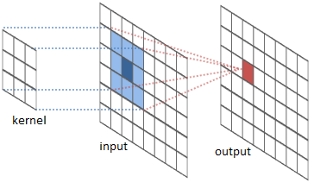
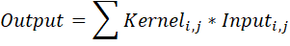
Convolutions
The kernel represents the pattern to be detected
The more the input matches the kernel, the more positive the output response would be
Convolutions are pattern detectors
The kernel weights are learned during training
i.e. it learns what patterns to detect and respond to
Image courtesy Titus Tang, Monash

Slide 15
A 3x3 Convolution Max
Convolution of an image by a 3x3 matrix replaces each pixel in an image by a weighted sum of those pixels adjacent to it, i.e.
I’(x,y) = a I(x-1,y+1) + b I(x,y+1) + c I(x+1,y+1)
d I(x-1,y) + e I(x,y) + f I(x+1,y)
g I(x-1,y-1) + h I(x,y-1) + i I(x+1,y-1)
Local Image Region
Convolution matrix
I(x-1,y+1) | I(x,y+1) | I(x+1,y+1)
I(x-1,y) | I(x,y) | I(x+1,y)
I(x-1,y-1) | I(x,y-1) | I(x+1,y-1)
a | b | c
d | e | f
g | h | i
Notes:
<number>
Obviously we can generalise to n x m matrices

Slide 16
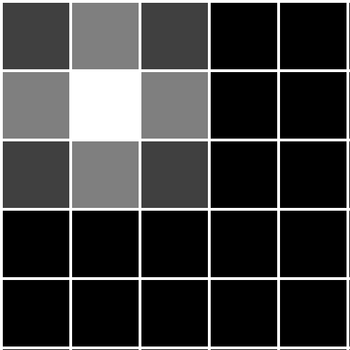
Convolution Example
0 | 0 | 0
0 | 1 | 1
0 | 1 | 1
Convolution
Image
Image x Convolution
0 | 0 | 0 | 0 | 0 | 0 | 0
0 | 0 | 0 | 0 | 0 | 0 | 0
0 | 0 | 1 | 1 | 0 | 0 | 0
0 | 0 | 1 | 1 | 0 | 0 | 0
0 | 0 | 0 | 0 | 0 | 0 | 0
0 | 0 | 0 | 0 | 0 | 0 | 0
0 | 0 | 0 | 0 | 0 | 0 | 0
1 | 2 | 1 | 0 | 0
2 | 4 | 2 | 0 | 0
1 | 2 | 1 | 0 | 0
0 | 0 | 0 | 0 | 0
0 | 0 | 0 | 0 | 0

Slide 17
Max Pooling with step size 2
10 | 6 | 6 | 0
5 | -3 | 14 | -2
0 | 2 | -7 | -3
0 | 0 | -5 | -5
10 | 14
2 | -3
Input 4x4 image
Output 2x2 image
Slide a window across the input and pick a value at every window position.
Max pooling – take the max value.
Average pooling – take the average value.
Pooling layers are information filters.
Images are reduced in scale, typically by ½ x ½
Slide courtesy Titus Tang, Monash

Slide 18
Spatial Dropout Layers
Dropout regularisation is a simple computational method to prevent over-fitting to data
SpatialDropout2D in Keras drops (sets to 0) entire feature maps with a given probability during training
Helps promote independence between feature maps

Slide 19
Up Convolutions (scaling up)
10 | 6 | 6 | 0
5 | -3 | 14 | -2
0 | 2 | -7 | -3
0 | 0 | -5 | -5
10 | 14
2 | -3
Also known as transpose convolutions
Max pooling scales an image down (½ x ½ smaller)
Up Convolutions scale an image up (e.g. 2 x 2 bigger)
Want 4 pixels to become 16
Roughly (??) it works by:
Rearrange 2x2 input to be 4x1
Rearrange a 3x3 kernel into a 16x4 by repeating entries
The 16x4 then maps a 4x1 to a 1x16
Rearrange 1x16 to a 4x4 output

Slide 20
Skip Connections
Copy some of the outputs from the scaling down to the scaling up side
Crop middle and copy, add/combine with up side of the network

Slide 21
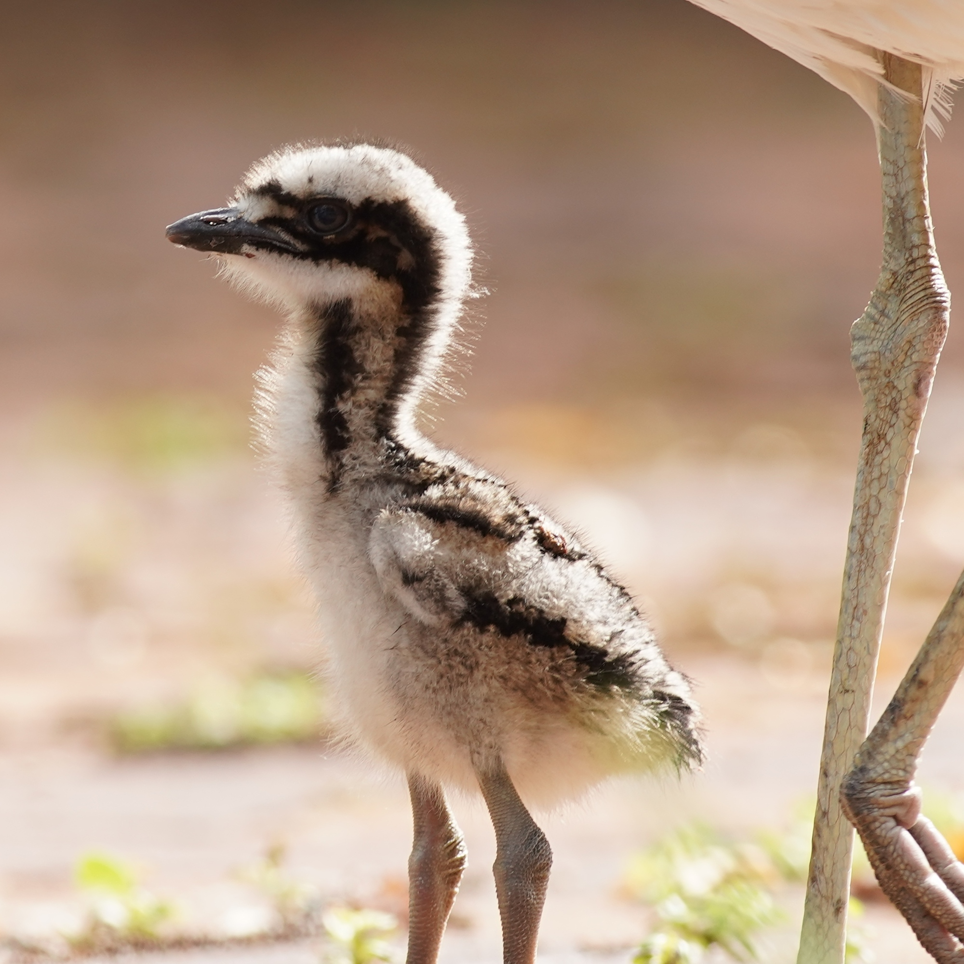
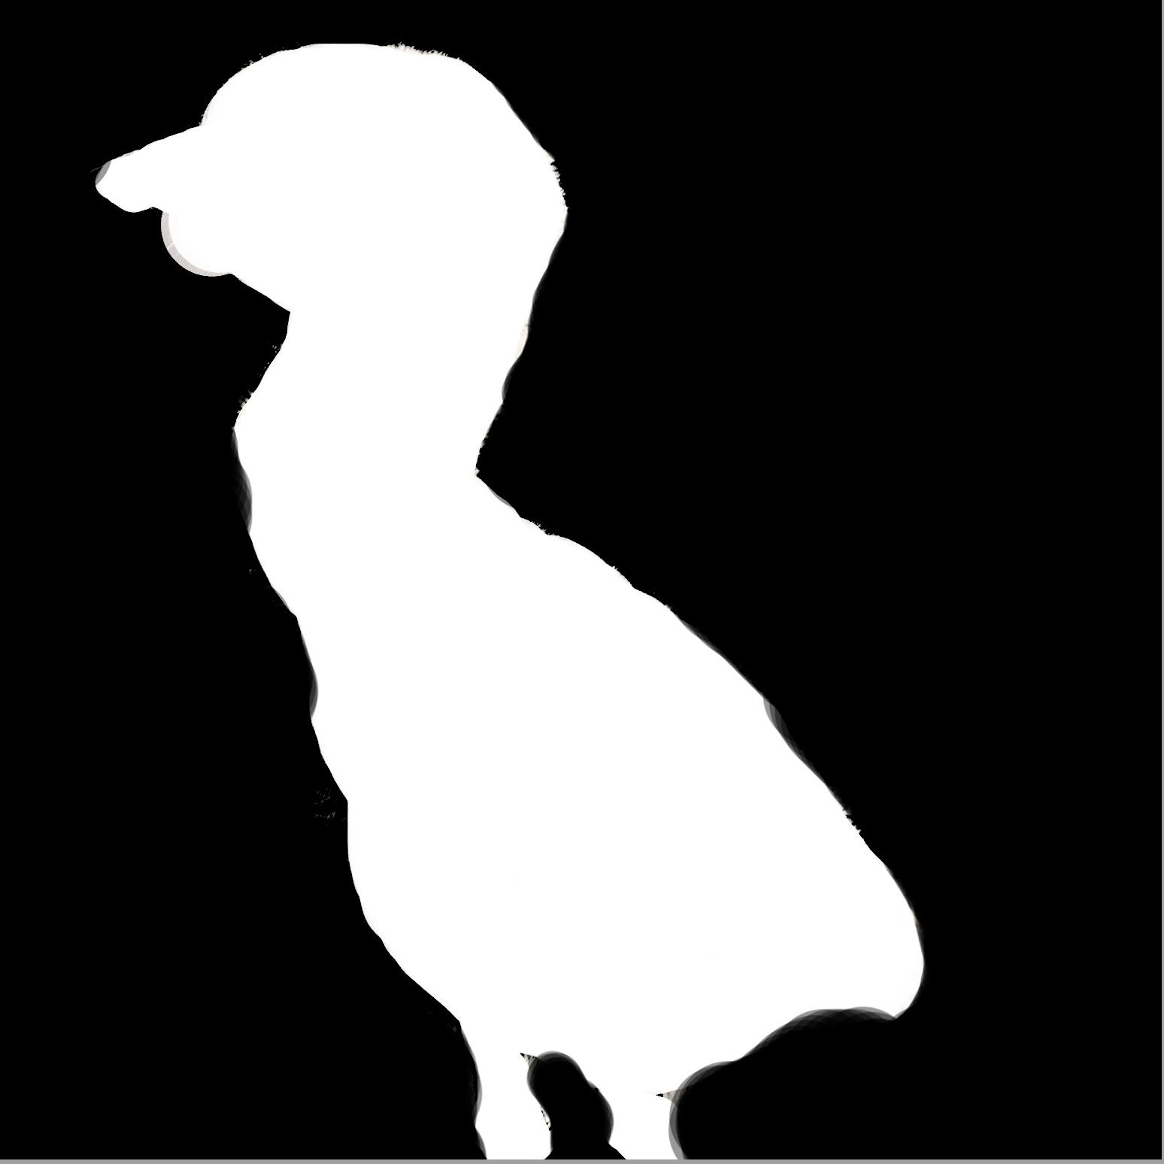
UNET Output Segmentation
Output is a binary image that selects the object region
May be multiple binary images, one for each object class
Note that while the input is 572x572 output is 388x388
Lose some of the edges due to convolutions
Later versions of U-Net use padding for convolutions to maintain original image size

Slide 22
Padding Convolutions
Suppose we had a 4 x 4 image & we applied a 3x3 convolution
The centre of 3x3 conv can only fit in the green squares above
Input 4x4 image
Output 2x2 image
0 | 0 | 0 | 0 | 0 | 0
0 |  |  |  |  | 0
0 |  |  |  |  | 0
0 |  |  |  |  | 0
0 |  |  |  |  | 0
0 | 0 | 0 | 0 | 0 | 0
0 | 0 | 0 | 0 | 0 | 0
0 |  |  |  |  | 0
0 |  |  |  |  | 0
0 |  |  |  |  | 0
0 |  |  |  |  | 0
0 | 0 | 0 | 0 | 0 | 0
Padded 6x6 input image
Output 4x4 image

Slide 23
U-net

Slide 24
UNET Advantages and Disadvantages
Fast to segment
Field-leading accuracy for segmentation
Do not need large numbers (1000s) of examples
Does not separate objects of same type
Labor intensive to create manual segmentations for training
- Every training image needs to be completely segmented
- Conversely, a basic pixel classifier approach does not need this
Now implemented in Keras / tensorflow for easy use

Slide 25
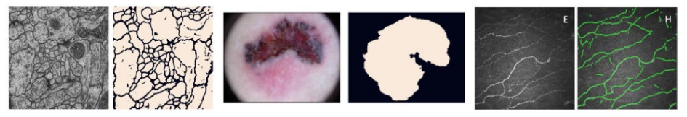
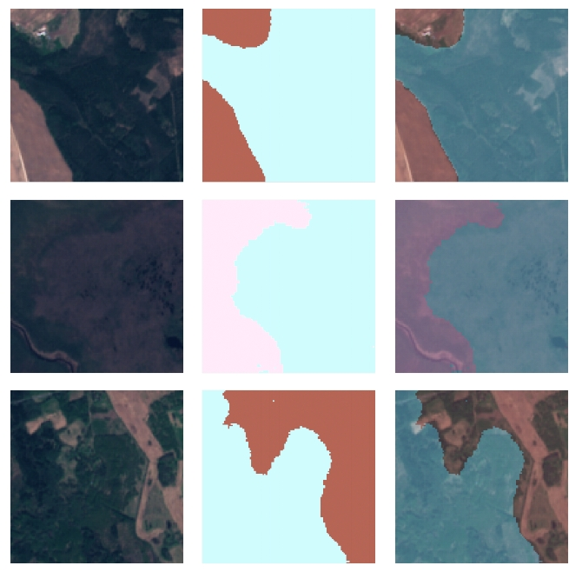
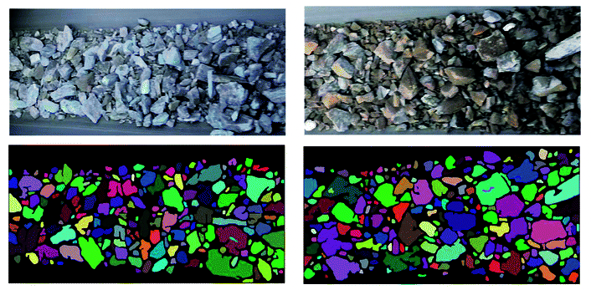
Real-World Applications of U-Net
Medical images https://arxiv.org/pdf/2011.01118.pdf
Ore segmentation
https://pubs.rsc.org/en/content/articlelanding/2020/ra/c9ra05877j
Satellite Images
https://arxiv.org/pdf/2003.02899.pdf

Slide 26
U-Net in Keras
Three U-net networks are built into Keras
Vanilla: based in the original implementation of U-Net
Custom: a customisable U-Net architecture
Satellite: optimised for satellite imaging
There are also several utility functions to help with training and visualisation of the data and model outputs
Documentation: https://pypi.org/project/keras-unet/
Keras U-Net model python code:
https://github.com/karolzak/keras-unet/tree/master/keras_unet/models

Slide 27
Some UNET Resources
A line by line explanation/construction of UNET in tensorflow
https://towardsdatascience.com/unet-line-by-line-explanation-9b191c76baf5
The original U-net paper
https://arxiv.org/pdf/1505.04597.pdf
U-net in Keras
https://pypi.org/project/keras-unet/
Keras documentation on layer types
Convolution: https://keras.io/api/layers/convolution_layers/convolution2d/
Max Pooling: https://keras.io/api/layers/pooling_layers/max_pooling2d/
Conv Transpose: https://keras.io/api/layers/convolution_layers/convolution2d_transpose/
Dropout: https://keras.io/api/layers/regularization_layers/dropout/
An explanation of Up Sampling
https://naokishibuya.medium.com/up-sampling-with-transposed-convolution-9ae4f2df52d0

Slide 28
Data Preparation, Training UNET
and Evaluating the Results

Slide 29
Creating a Training Set
In to create a U-net segmenter, you will need to create a set of labeled examples
This represents the ground truth that U-net will learn
This is typically a laborious and boring process drawing outlines on numerous images
How many you will need will depend on the problem
Data augmentation during training can reduce the number

Slide 30
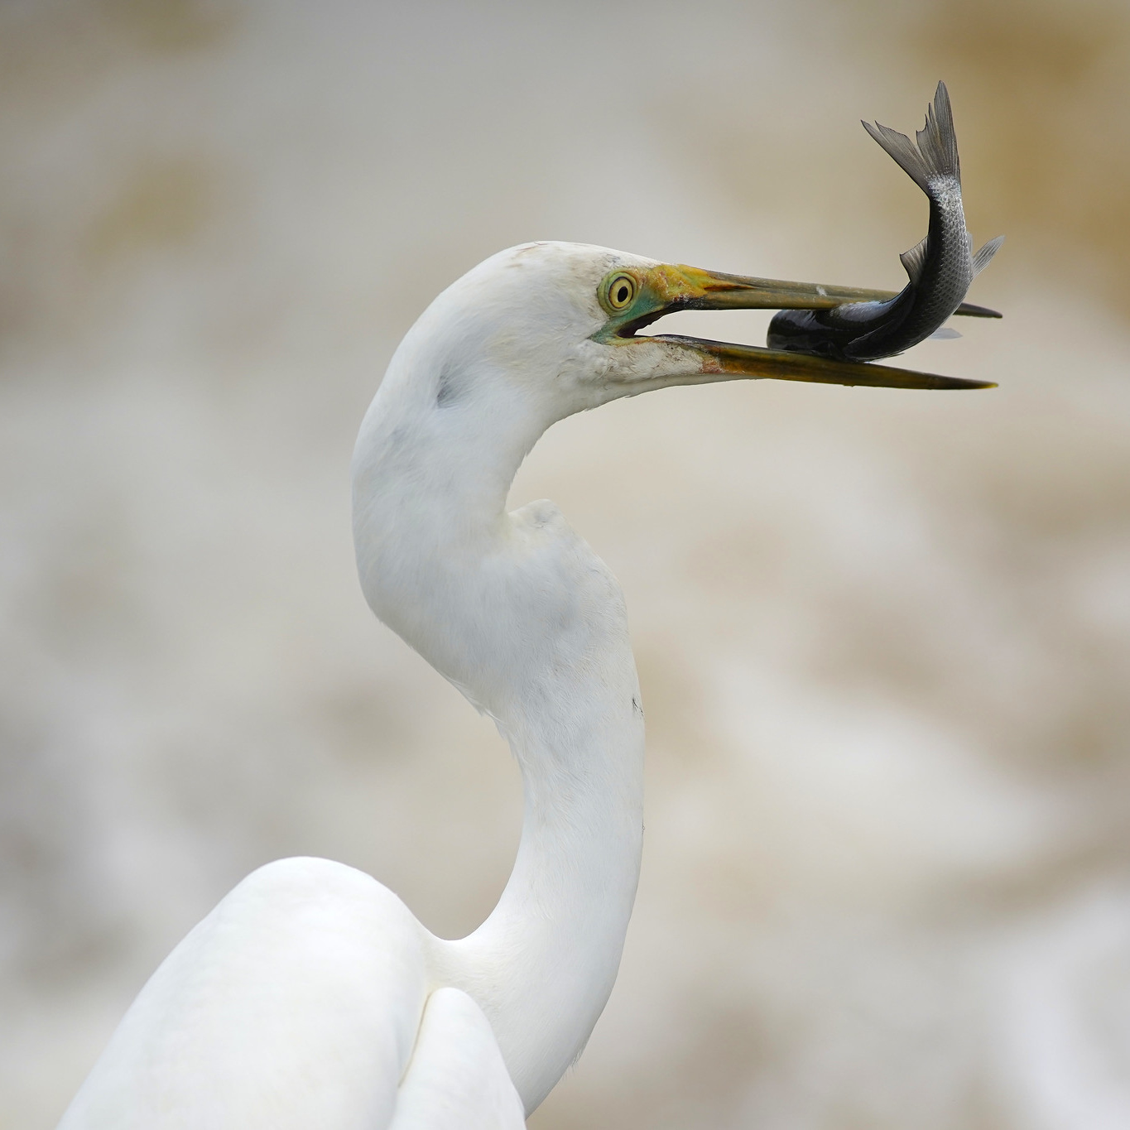
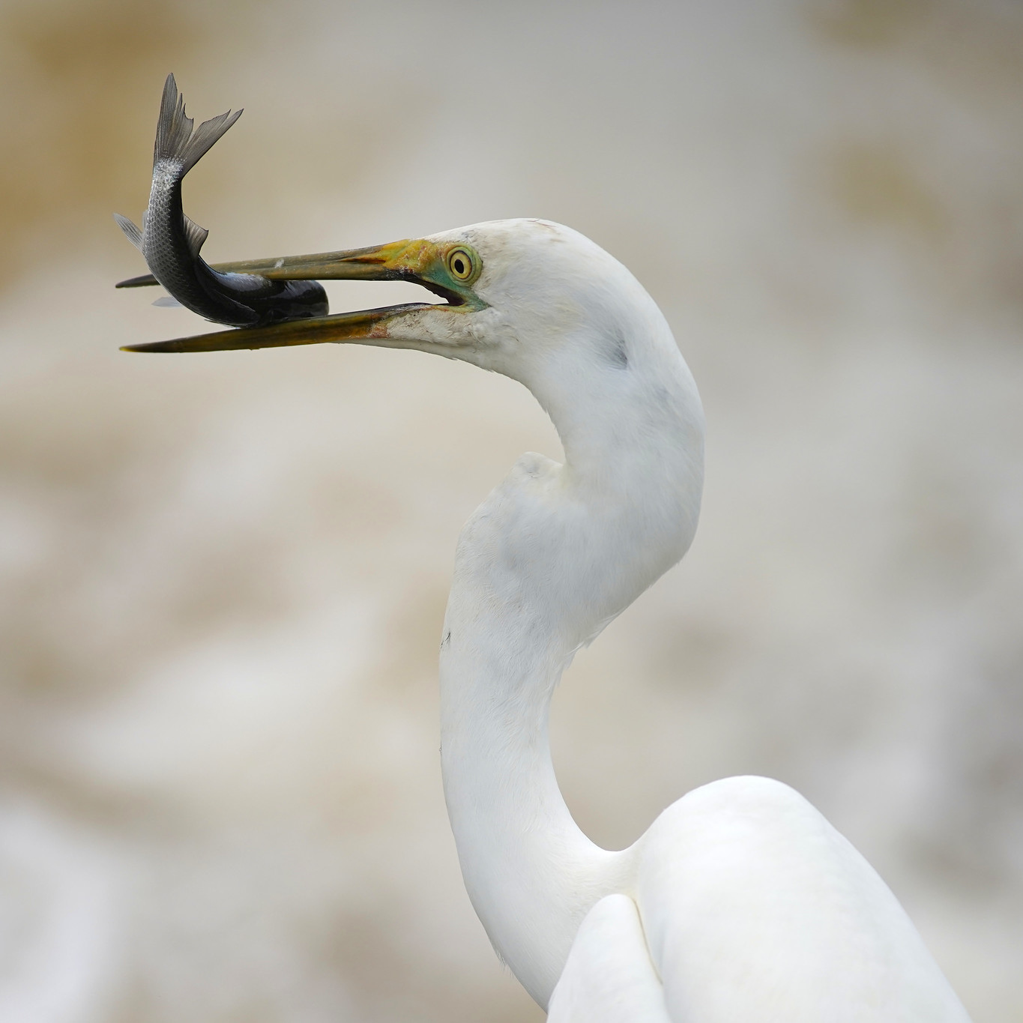
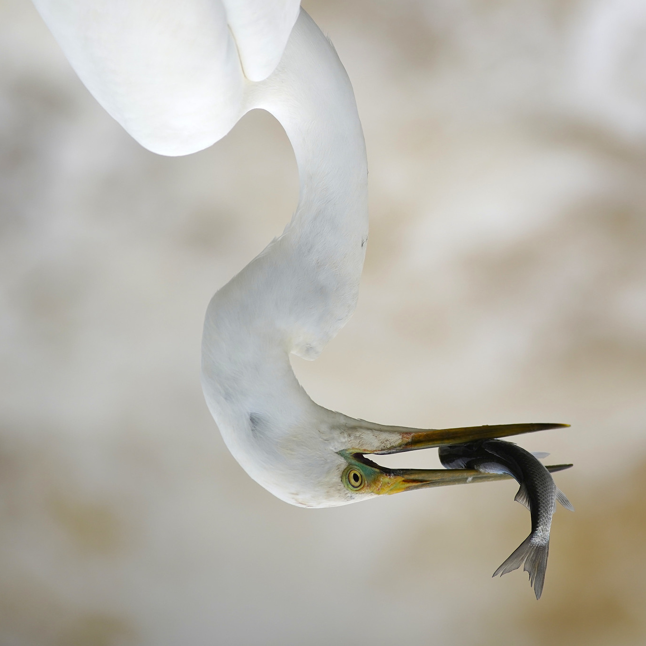
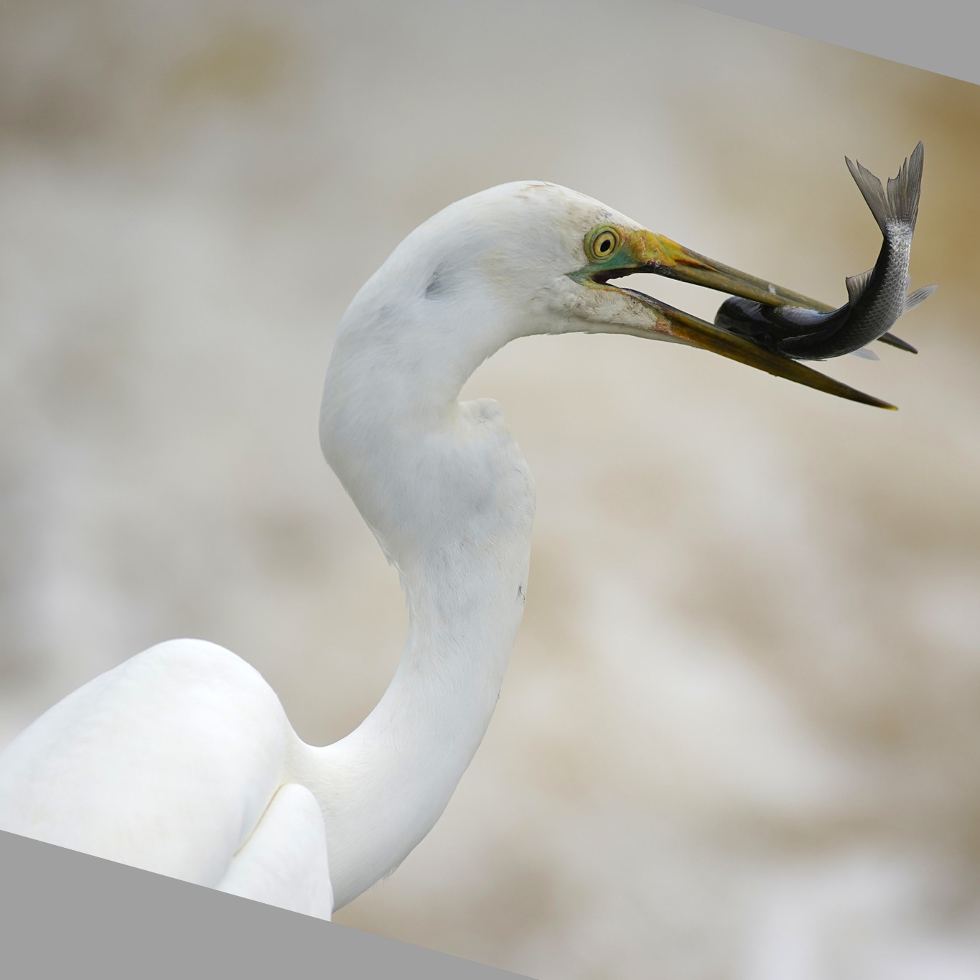
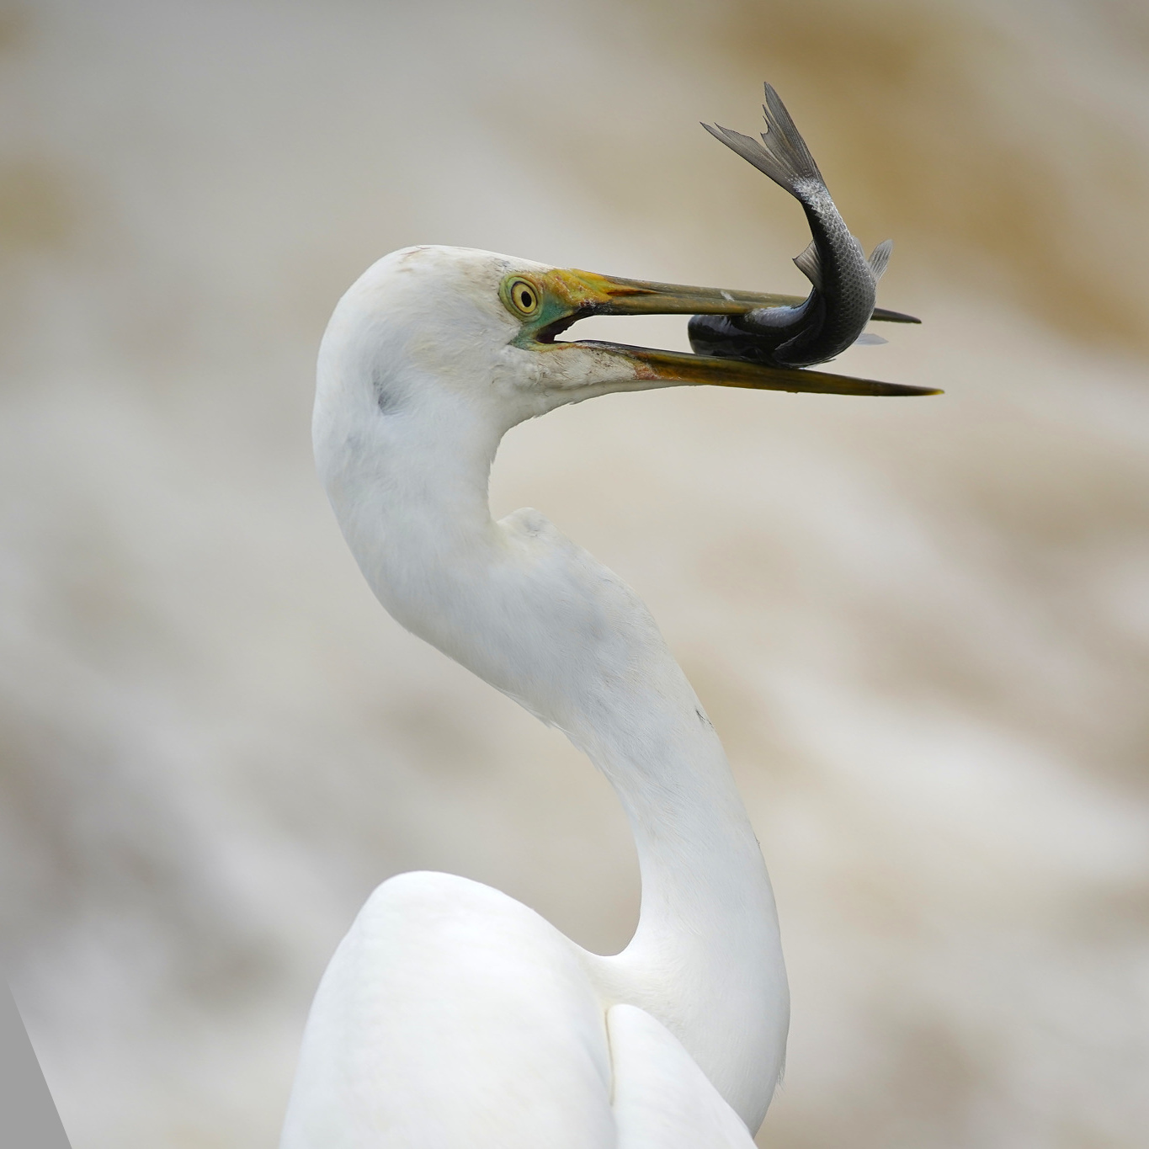
Data Augmentation for Imaging
Creating image sets is time consuming and there may be limited numbers of examples available
One approach to extending a set of images is to apply geometric transformations to create new examples
Keras has ImageDataGenerator and flow_from_directory
Keras-Unet has get_augmented function
Original Flip horizontal Flip vertical Rotate Shear

Slide 31
Image Batch Generators for Training
Usually, image sets are too large to present all at once during training as they will not fit in CPU/GPU memory
Also calculations to update network weights may get too large
Hence training usually occurs in batches, where subsets of images of a fixed size are selected and trained on
Subsets are repeatedly drawn from the training set, and the network trained, until all of the training set had been presented
The process is usually repeated multiple times
In Keras you can set batchsize as a parameter to model.fit and pass all of your training data to model.fit (memory expensive)
Or you can use one of the batch generators, and pass that to the model.fit function (we will see examples in the code).

Slide 32
Using Google Colab
Colab is a web-based iPython Notebook service
You can play/run blocks of python code interactively
Your code can run on Googles CPU/GPU or TPU in the cloud
It is free but has usage limitations
Using Tensorflow with image applications on Colab with GPU can be 10 or 20 times faster than with CPU
( In Colab set Runtime / Change Runtime Type → GPU)
TPUs are Tensorflow Processing units – designed for Tensorflow
Colab Code is interchangeable with Jupyter Notebooks
Colab basics:
https://colab.research.google.com/drive/1YKHHLSlG-B9Ez2-zf-YFxXTVgfC_Aqtt

Slide 33
Setting up Google Colab for the Workshop
Create a folder in your Google Drive called Colab Notebooks
Download code and slides for this workshop:
https://github.com/doktor-nick/intro-to-ml-for-imaging/archive/master.zip
Unzip it and copy the folder into Colab Notebooks
Go into the folder intro-to-ml-for-imaging-master
Right-click on Unet_in_Keras_introduction.ipynb
Select Open with / + Connect more apps
Search for and install Colaboratory
Double clicking on the Unet_in_Keras_introduction.ipynb should open it in Colab
When running the code for the workshop you will need to link and authorise your Google Drive to be used by the notebook. The provided notebook has code/instructions for doing this.

Slide 34
Hands On
Unet_in_Keras_introduction.ipynb
Colab Notebook

Slide 35
Optimisers, loss functions, and tiling

Slide 36
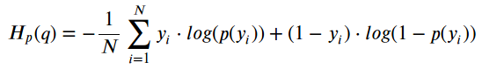
Measuring Success: Loss functions for imaging
A common measure of error/loss in machine learning is root mean square error (RMSE), i.e. the sum of the square of the differences between the real and predicted values
But predicting a segmentation is a binary problem,
1 = in object, 0 = not in object
Binary Cross-entropy a bit is like RMSE, but it is more punitive on getting a prediction in the wrong class.
The formula looks like this
More explanation here:
https://towardsdatascience.com/understanding-binary-cross-entropy-log-loss-a-visual-explanation-a3ac6025181a

Slide 37


Unbalanced problems and loss functions
One problem with RMSE and binary cross-entropy is that the not good when the problem is unbalanced, that is if there is a lot more of one class than another.
For instance,
Target Prediction
the RMSE between these two images is actually quite small because they agree a lot on the background

Slide 38
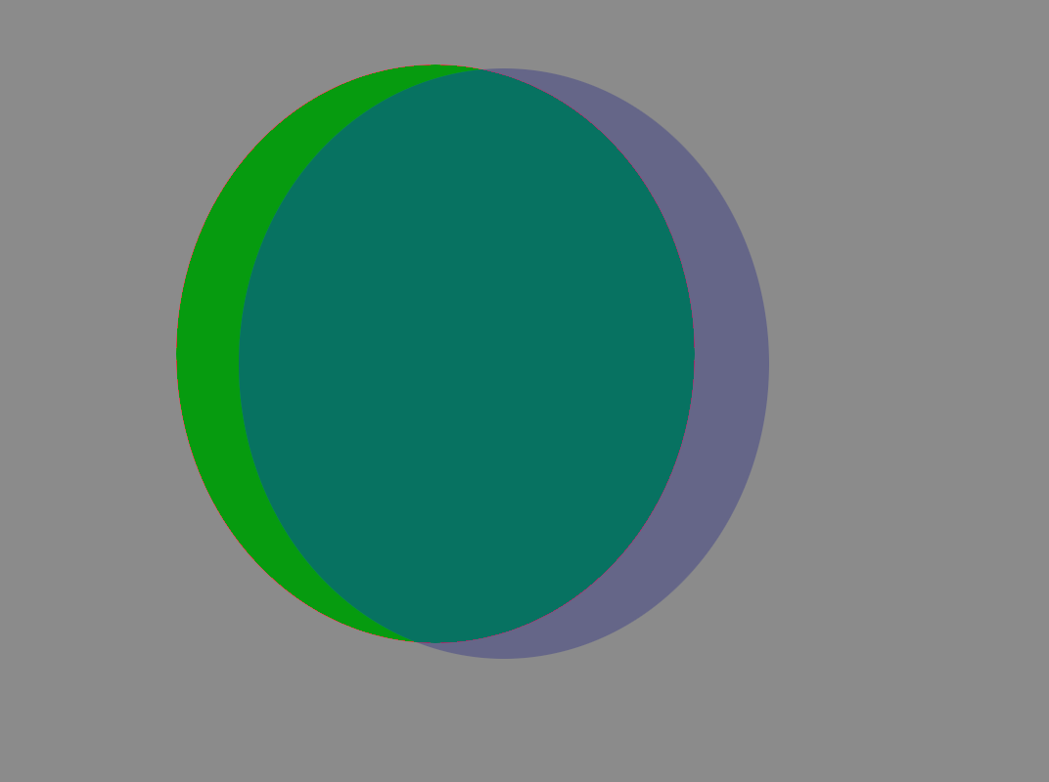
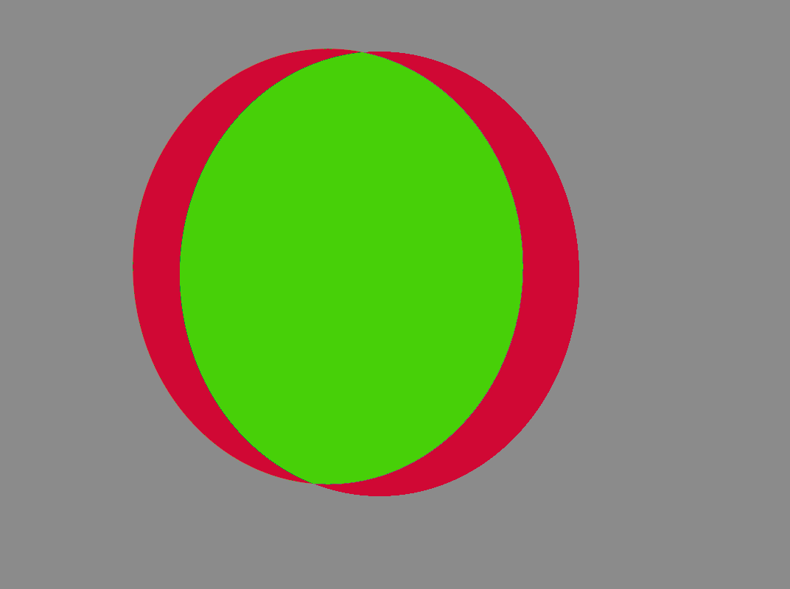
Jaccard loss : “intersection over union”
One problem with RMSE and binary cross-entropy is that the not good when the problem is unbalanced, that is if there is a lot more of one class than another.
Jaccard:intersection over union (|X & Y|)/ (|X|+ |Y| - |X & Y|)
More discussion on image metrics:
https://towardsdatascience.com/image-segmentation-choosing-the-correct-metric-aa21fd5751af
Agree
--------------------
Disagree + Agree
object prediction

Slide 39
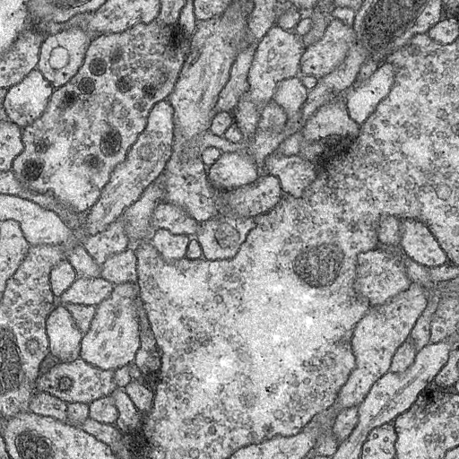
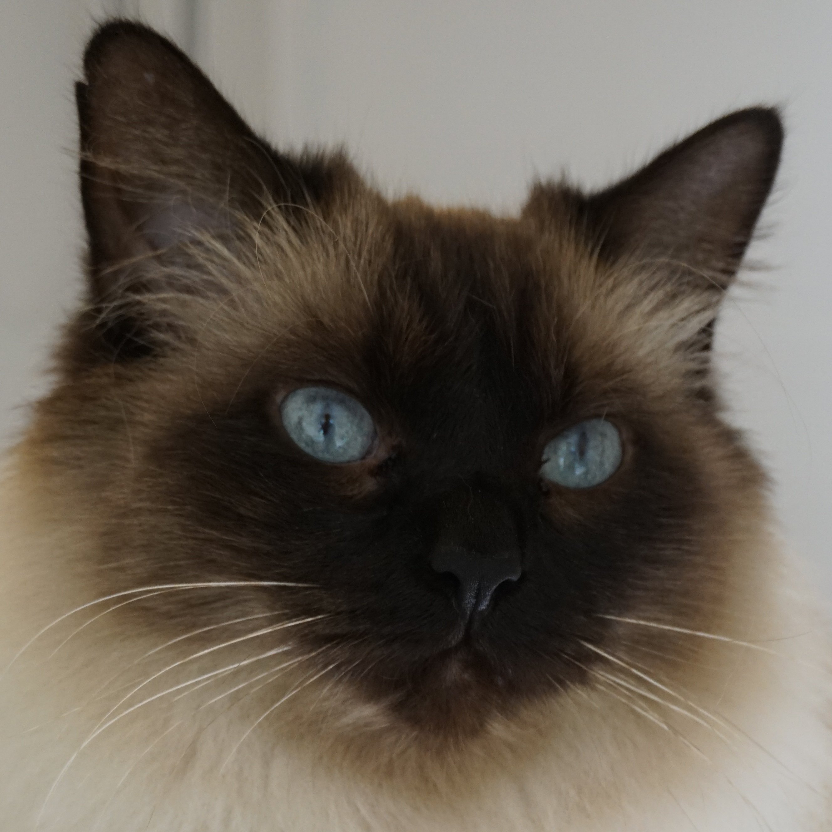
Image Tiling
Available memory on a GPU can often be an issue for imaging
During training, reducing batch size may help or scaling down
Tiling, that is chopping an image into smaller pieces is another approach
Care needs to be taken that each tile contains enough information so that it can be accurately segmented
Usually want to use overlapping tiles to avoid edge effects
The Keras Unet libraries can generate patches easily
??

Slide 40
Which Optimiser for Semantic Image Segmentation?
In Keras there are a range of optimisers available including SGD, RMSprop, Adam, Adadelta, Adagrad, Adamax, Nadam Ftrl
Performance may vary according to the application
Generally Adam and SGD are reasonable choices
For a discussion of different optimiser types see
https://ruder.io/optimizing-gradient-descent/
For optimisers available in Keras see
https://keras.io/api/optimizers/

Slide 41
Overview of choices in network/evaluations
Optimiser: Adam
Loss function: Jaccard distance
Reduce batchsize, scale images down, or tile if size is a problem
Sometimes the optimiser will get stuck. It is worth running the fitting functions more than once to ensure better results

Slide 42
Hands on
Unet_in_Keras_further_topics.ipynb
Colab Notebook

Slide 43
The End

